Slide 1
C4E Central Repository Architecture
<customer_name>
201xx-xx-xx

Slide 2
Establish a central repository for C4E assets
Establishing a central repository for C4E assets encourages
self-service and collaboration for roles interacting with the Anypoint
Platform.
API designers can view existing API specifications and RAML fragments for quickly defining new capabilities during design
API developers can view an extensive library of connectors as well as code-based examples demonstrating their use
Project managers and solution architects can review existing APIs/integrations to support new projects/applications
C4E stakeholders can peruse the growing portfolio of APIs and integrations and can examine C4E performance KPIs
Best Practice: Have individual users sign up for a C4E “account” to ensure access to all materials across multiple platforms.

Slide 3
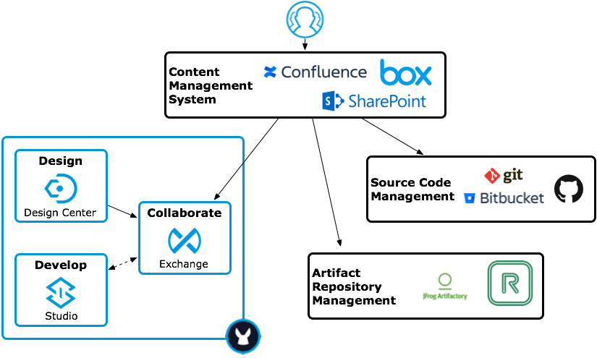
Establish a central repository for C4E assets

Slide 4



Establish a central repository for C4E assets
Content Management Systems (CMS)
C4E Mission Statement
C4E Charter
C4E Roles & Responsibilities
C4E Goals
Short-Term
Long-Term
KPIs
Onboarding Materials
Best Practices
Processes
Training Materials
How-To Guides
Standards
Diagrams

Slide 5



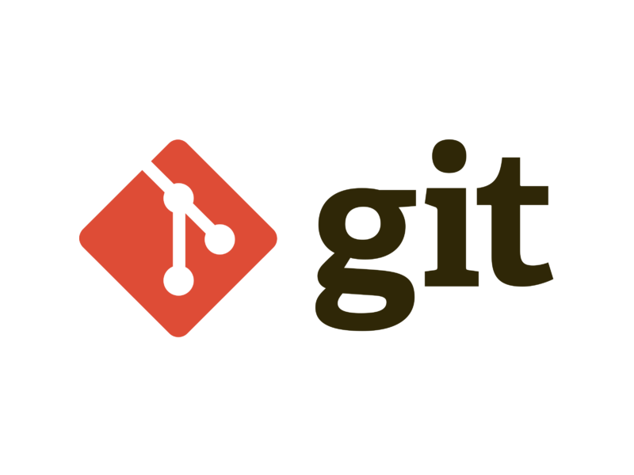
Establish a central repository for C4E assets
Exchange
Source Code Management (SCM)
Design Assets
API Specifications
RAML
WSDL
OAS
RAML Fragments
Development Assets
Connectors
Templates
Examples
Development Artifacts
Source Code
Configuration Files
Testing Artifacts
MUnit Tests
JUnit Tests
Deployment Artifacts
Scripts

Slide 6
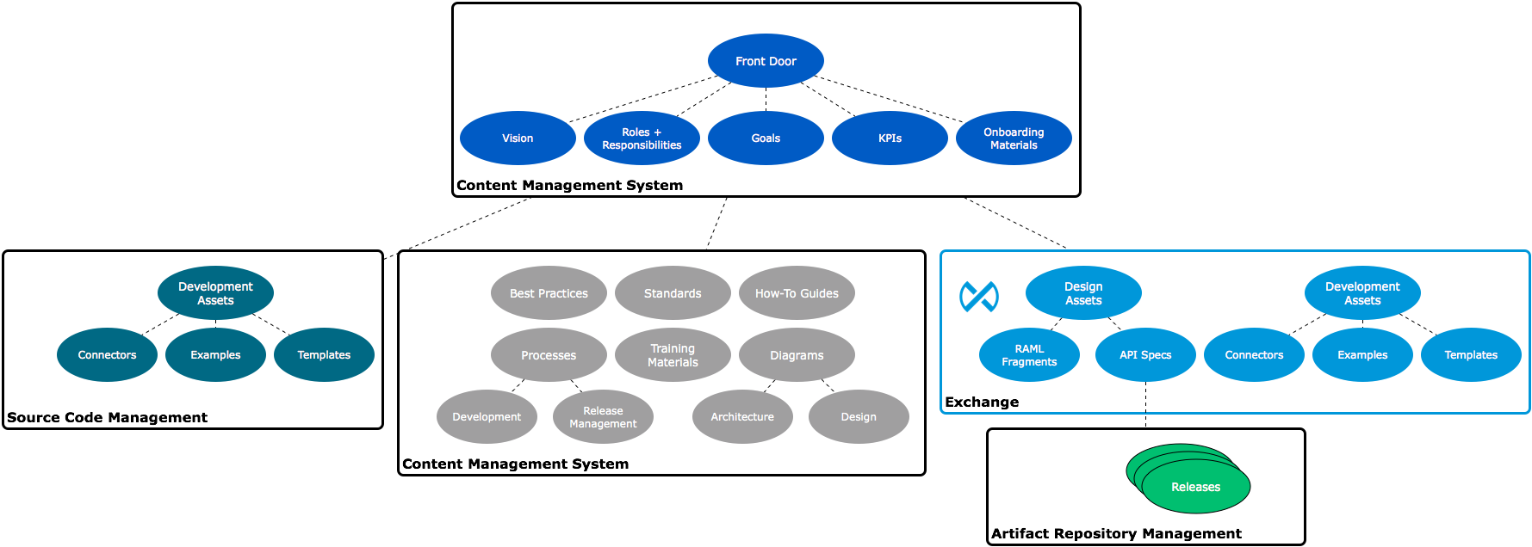
C4E Asset Taxonomy

Slide 7
Provide access to assets
A Center for Enablement encourages self-service and collaboration to increase adoption.
Every API should have a default “Try It” tier that provides automatic access for testing purposes.
The defined SLA should be very low (e.g. 1 request per second).
There should be nothing “in the back”.
There shouldn’t be separate internal/external sources of documentation.
Encourage consumers to rate assets and provide feedback on existing assets.
Feedback often leads to new APIs and more explicit documentation.
Reuse isn’t just for APIs.
Scripts, sample clients, data models, etc. should be checked-in and shared.
Either in Exchange, CMS, or a VCS/SCMS.

Slide 8
Exchange

Slide 9
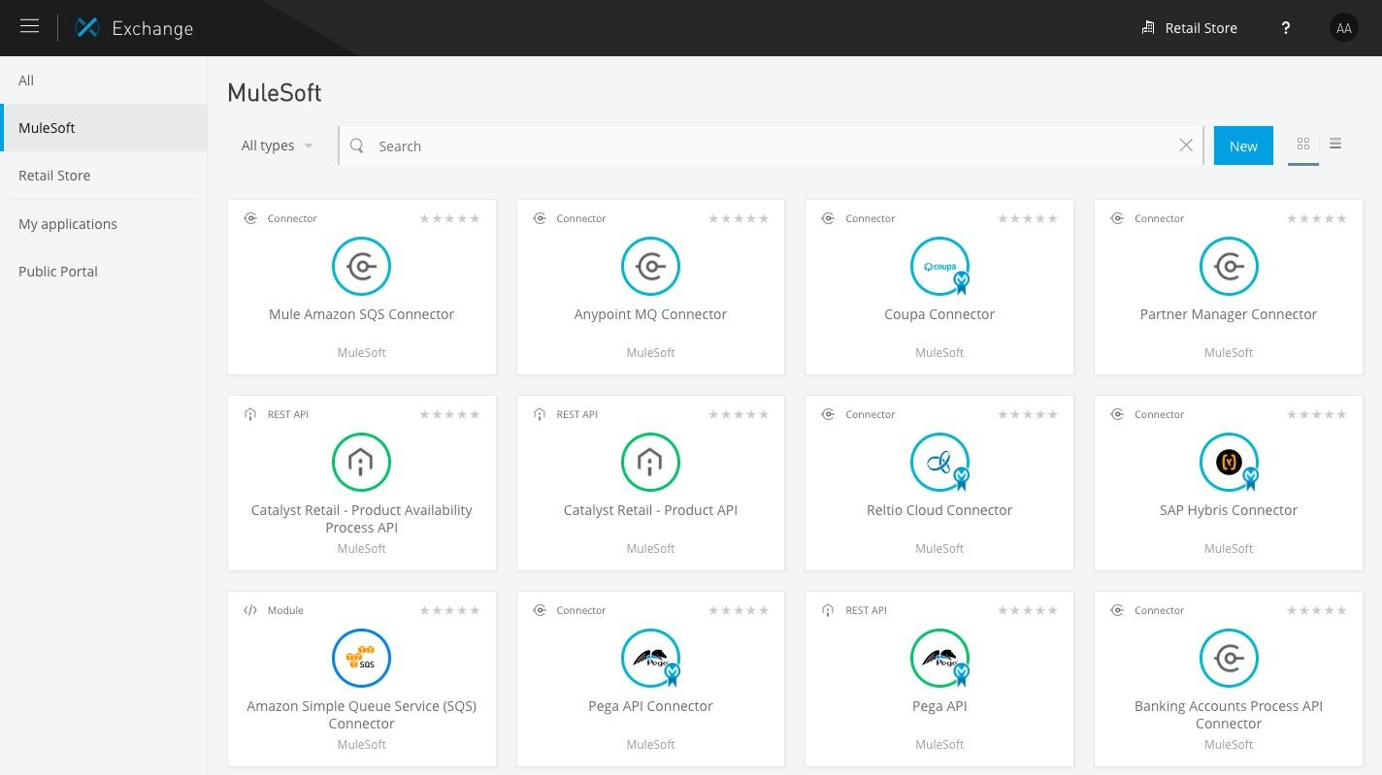
Use Exchange for sharing Mule-centric assets
Notes:
Demonstrate exchange for the sharing of Mule-centric assets (APIs, Connectors, Templates, Examples)

Slide 10
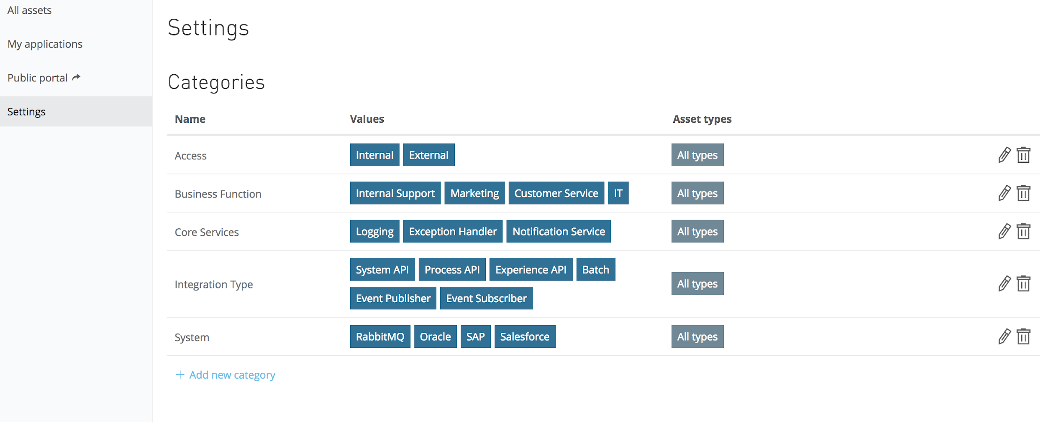
Define the Exchange Asset Taxonomy
An Asset Taxonomy is the means of classification used to categorize and organize integration assets.
An Asset Taxonomy is a hierarchical structure on which Exchange uses to make assets findable through searching and filtering.
A consistent Asset Taxonomy should be the first step in configuring Anypoint Exchange.

Slide 11
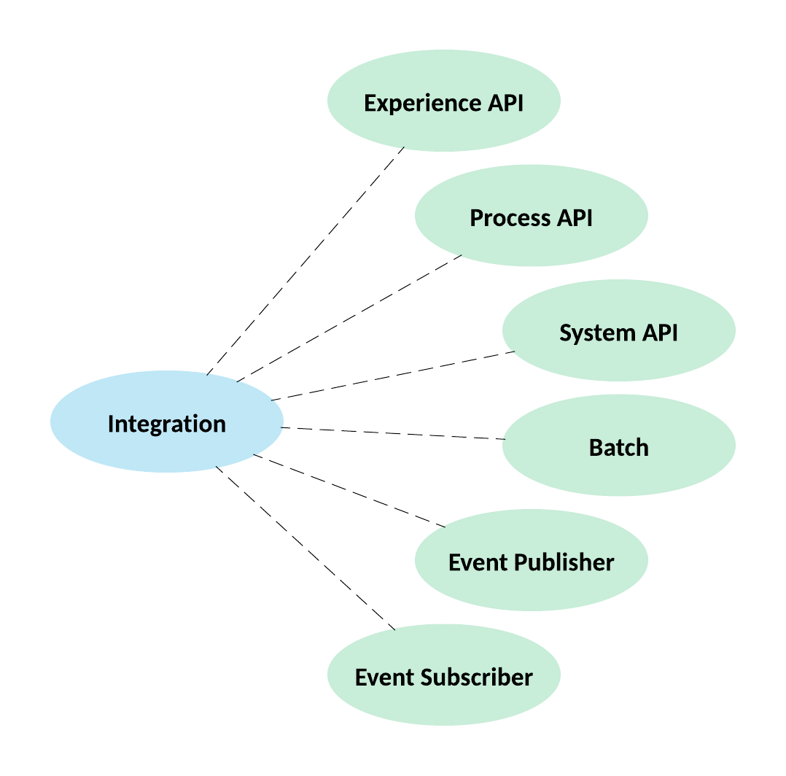
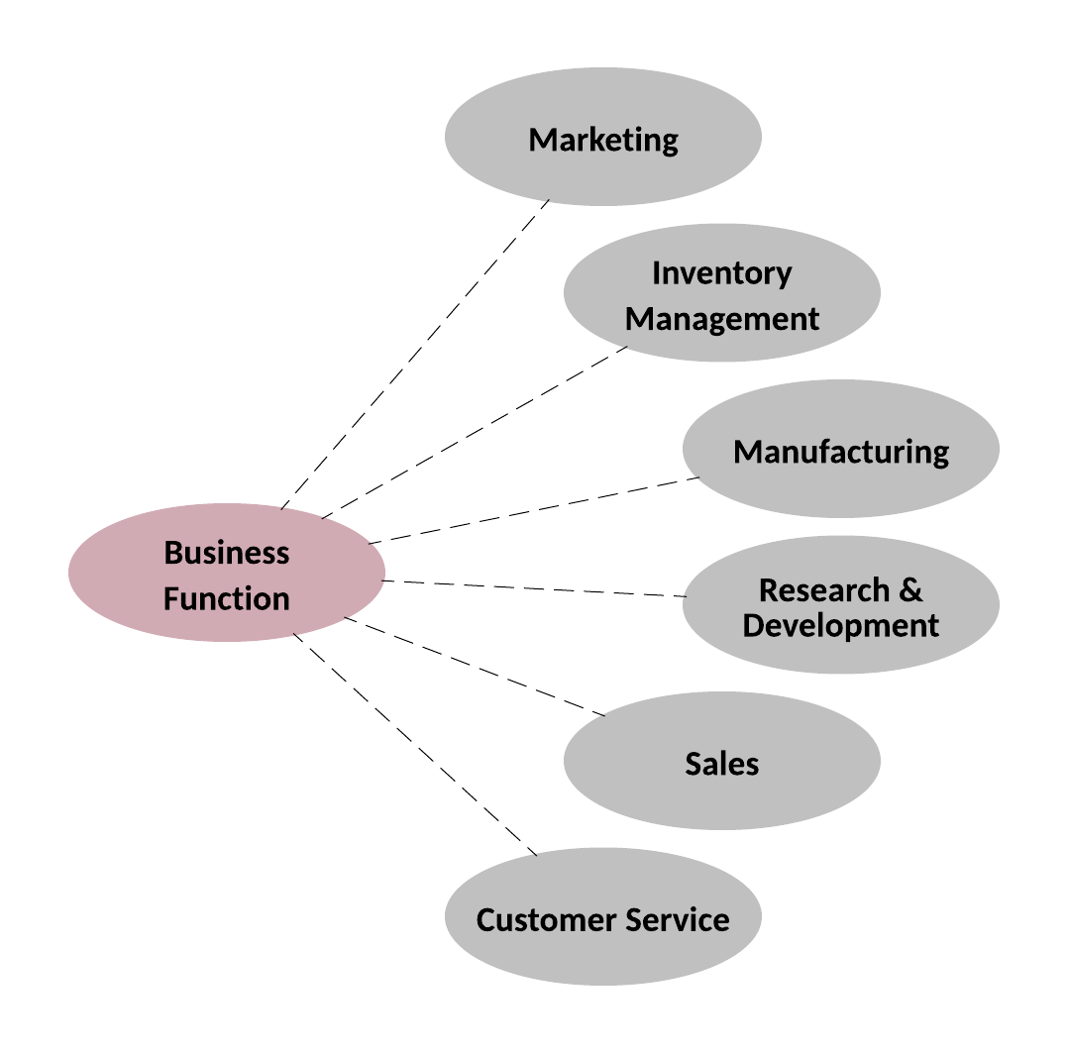
Exchange Asset Taxonomy Options

Slide 12
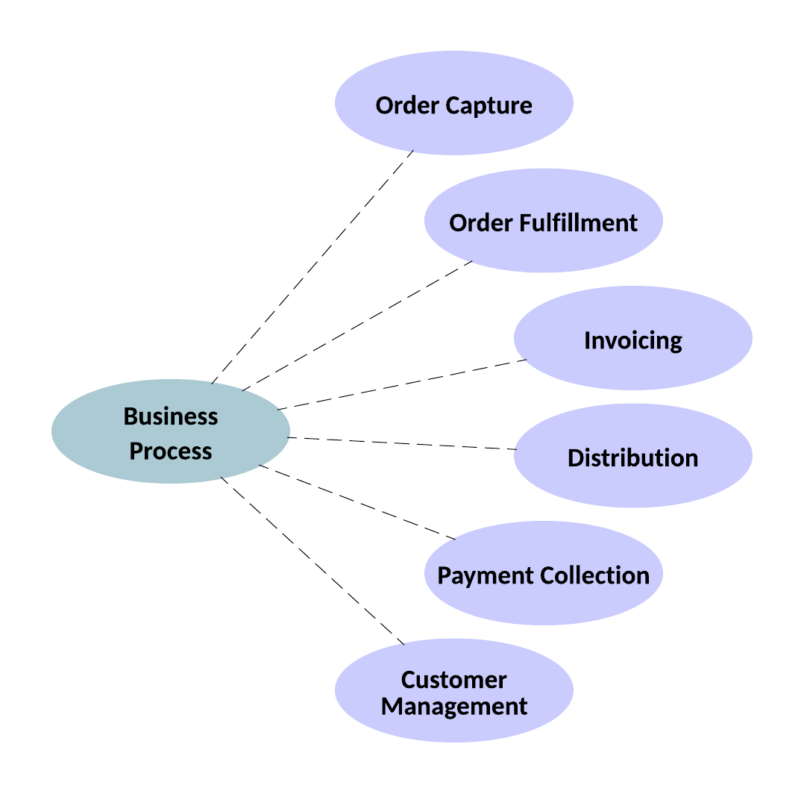
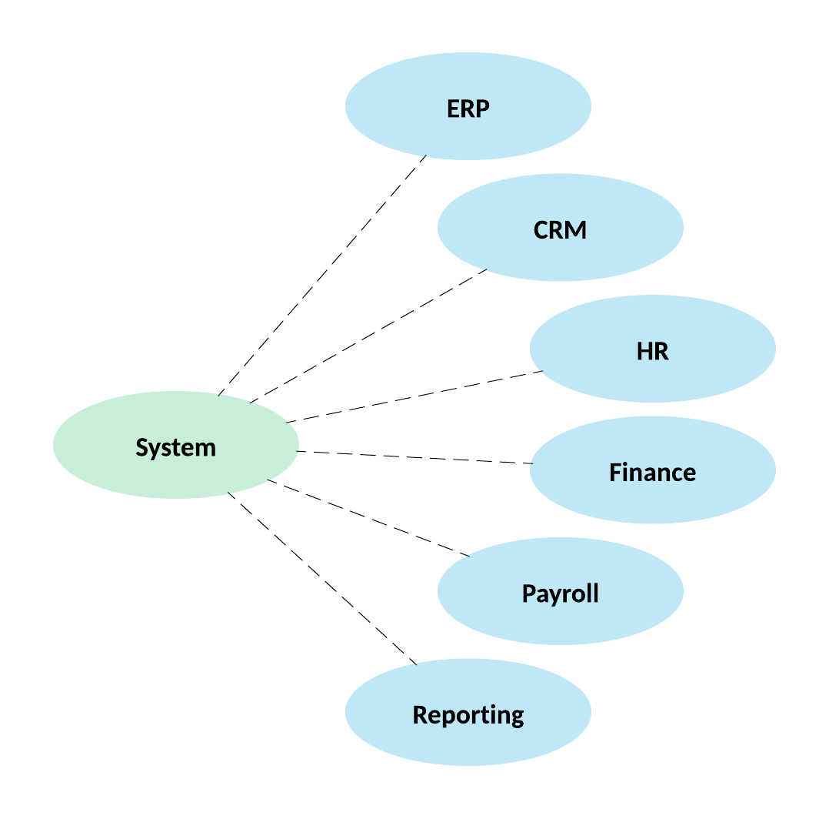
Exchange Asset Taxonomy Options

Slide 13
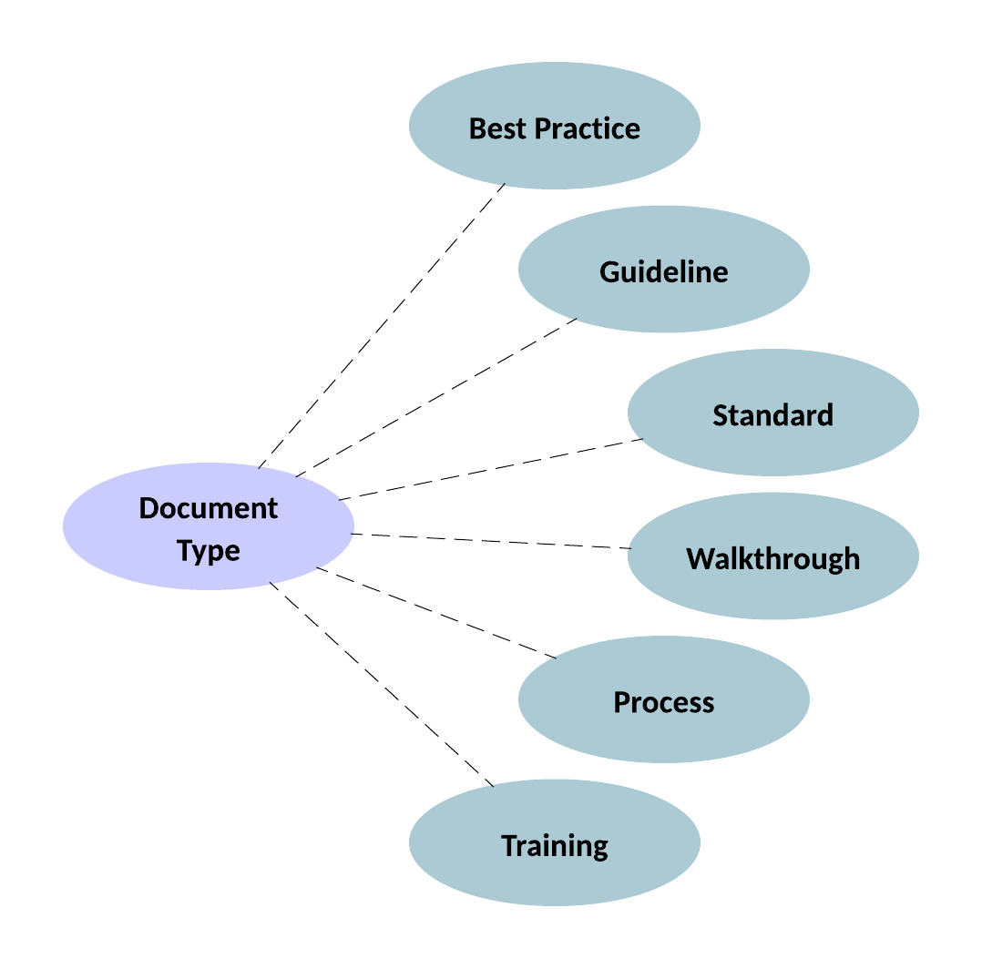
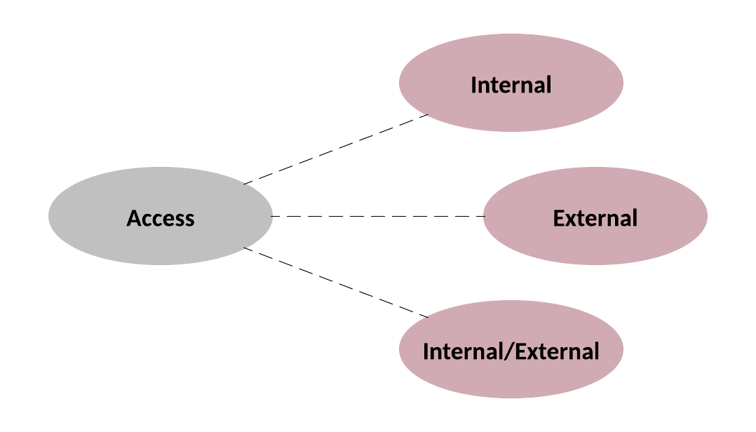
Exchange Asset Taxonomy Options

Slide 14
Thank You

